Slide 1
OPTIMIZING LOAN APPROVALS: A DATA-DRIVEN MODEL FOR ASSESSING INSTALLMENT-TO-INCOME RISK
DSCI 550 TEAM 6
RAVISH KAMATH | EDDIE ZHAO | JACKSON CRAWFORD | CAMERON ELA

Slide 2
PROBLEM
Objective: Improve loan default prediction for peer-to-peer loans (LendingClub).
Background: Current models underperforming, negatively affecting loan decision-making. Non-guarantee of future results. (Cornell 2020 Study)
Task: Develop an advanced model to predict default probabilities including both quantitative and behavioral factors.
Goal: Refine loan approval criteria to manage risk effectively.

Slide 3
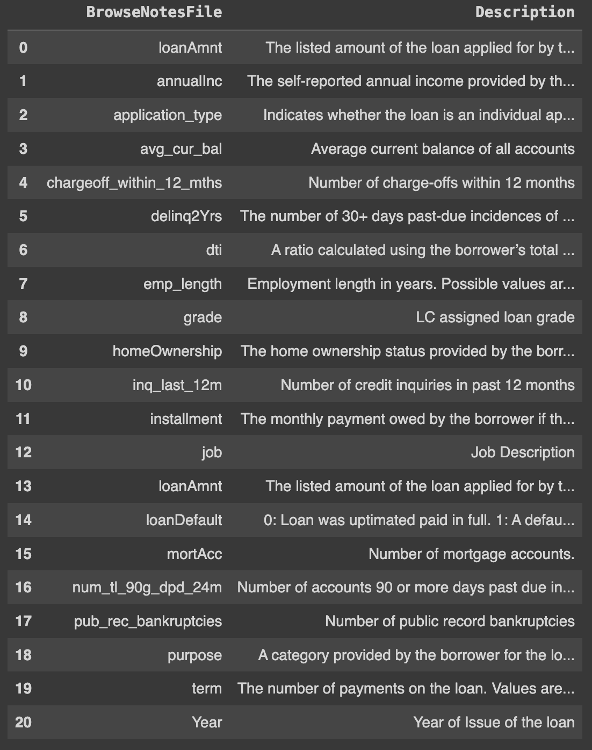
DATASET AND DESCRIPTION
Source: LendingClub (open source)
Key attributes:
- Loan Default (Target Variable)
Loan Amount
Expiration Date
Installment
Annual Income

Slide 4
QUESTION AND HYPOTHESIS
Does a higher installment-to-income ratio increase the likelihood of loan defaults on the LendingClub platform?
Hypothesis: The ratio of loan installments to annual income is directly associated with an increased risk of loan default, suggesting that borrowers whose loan repayments constitute a larger fraction of their income are more prone to financial distress, leading to a higher probability of default.

Slide 5
EXPLORATORY DATA ANALYSIS

Slide 6
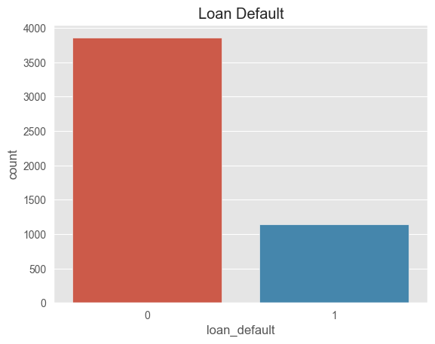
TARGET VARIABLE
Found around 20-25% default
Issue: Bias towards non-default cases in dataset.
Solution: Resample dataset to balance categories equally.
Evaluation: Use F1 Score to determine model success.

Slide 7
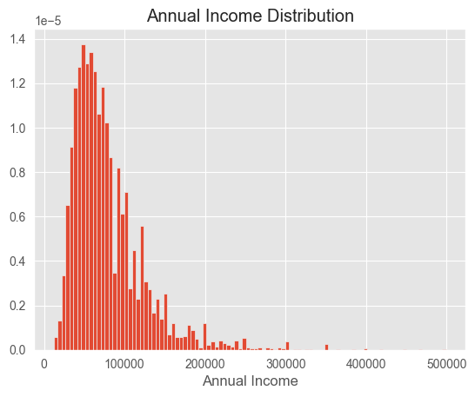
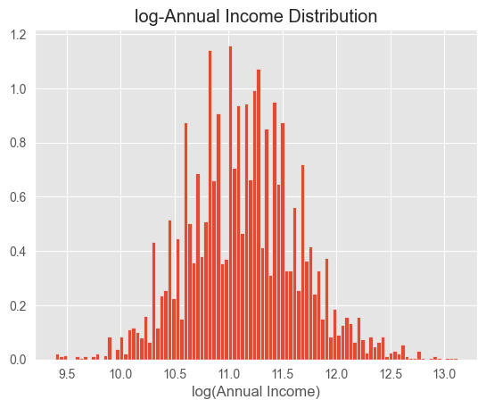
ANNUAL INCOME

Slide 8
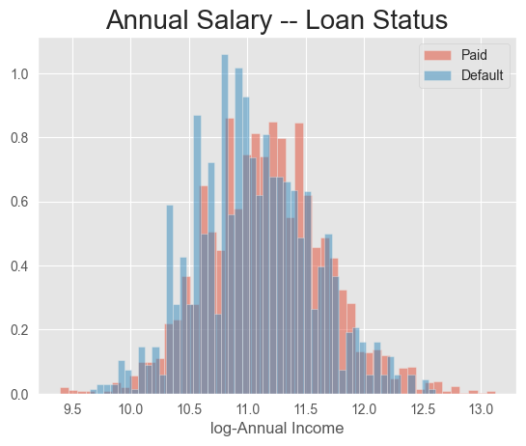
ANNUAL INCOME ON DEFAULT STAT
Observation: Similar distribution of annual income across both groups.
Implication: Income may not significantly explain differences in loan status.

Slide 9
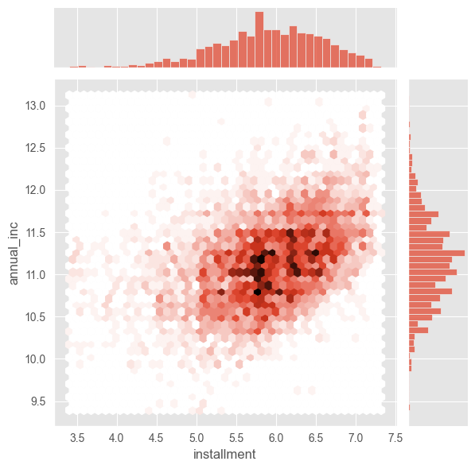
ASSOCIATION: ANNUAL INCOME & MONTHLY INSTALLMENTS
Analysis Focus: Relationship between annual income and monthly installments.
Observation: A mostly linear relationship between the two variables.
Note: A few outliers present on the far left.

Slide 10
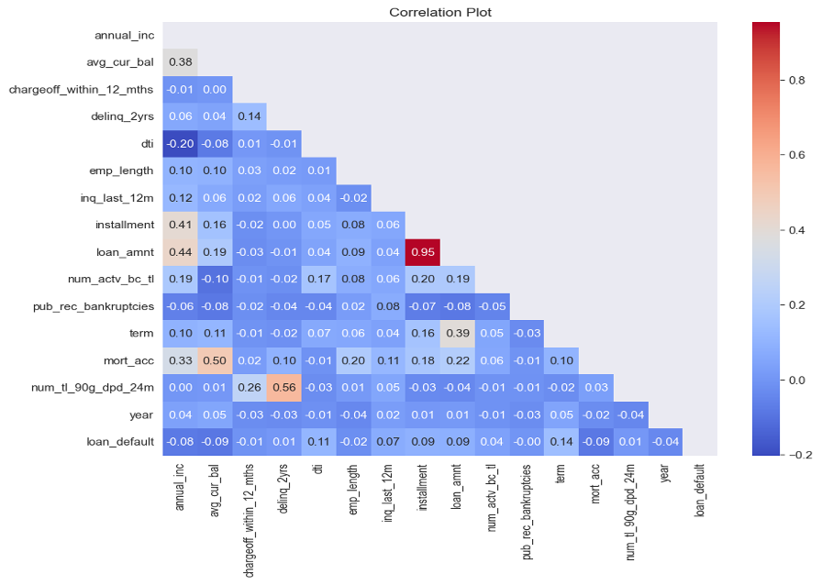
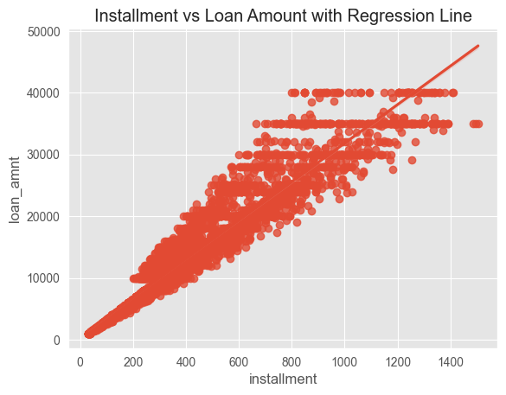
CORRELATION PLOT

Slide 11
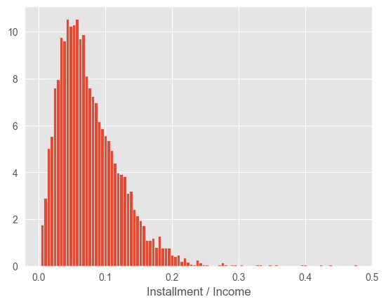
NEW VARIABLE
Metric for Loan Issuance: Yearly payment owed by borrower (as a fraction of their annual income).
New Variable Creation: Calculate this metric using installment and annual income.
Formula: Install_income = 12 * Installment / Annual Income.

Slide 12
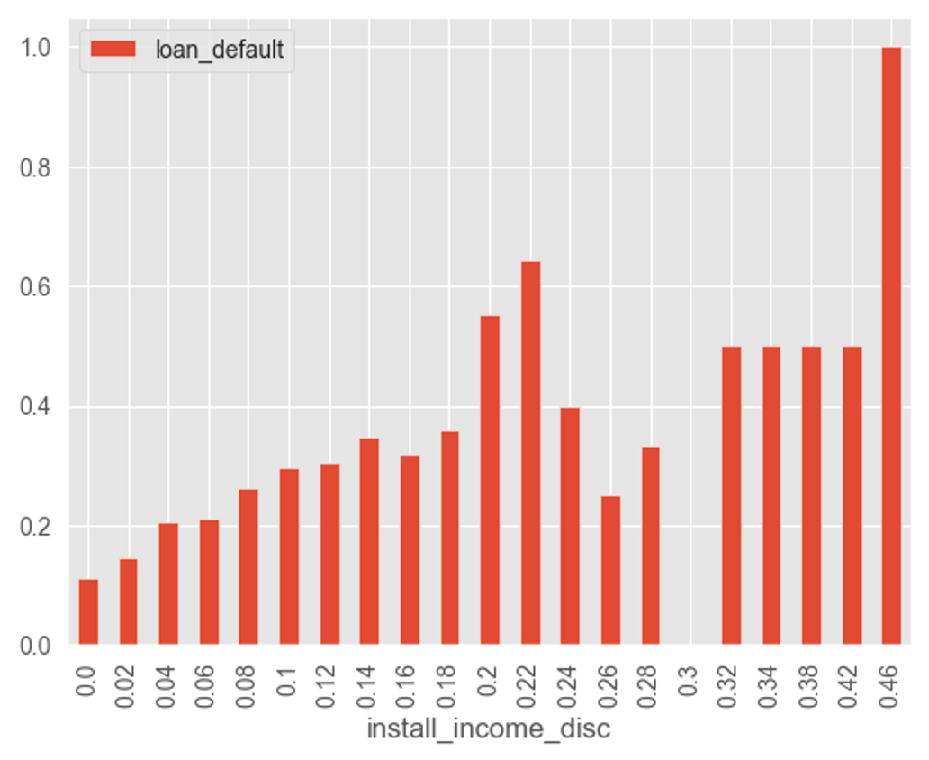

Slide 13
THANK YOU

